Slide 1

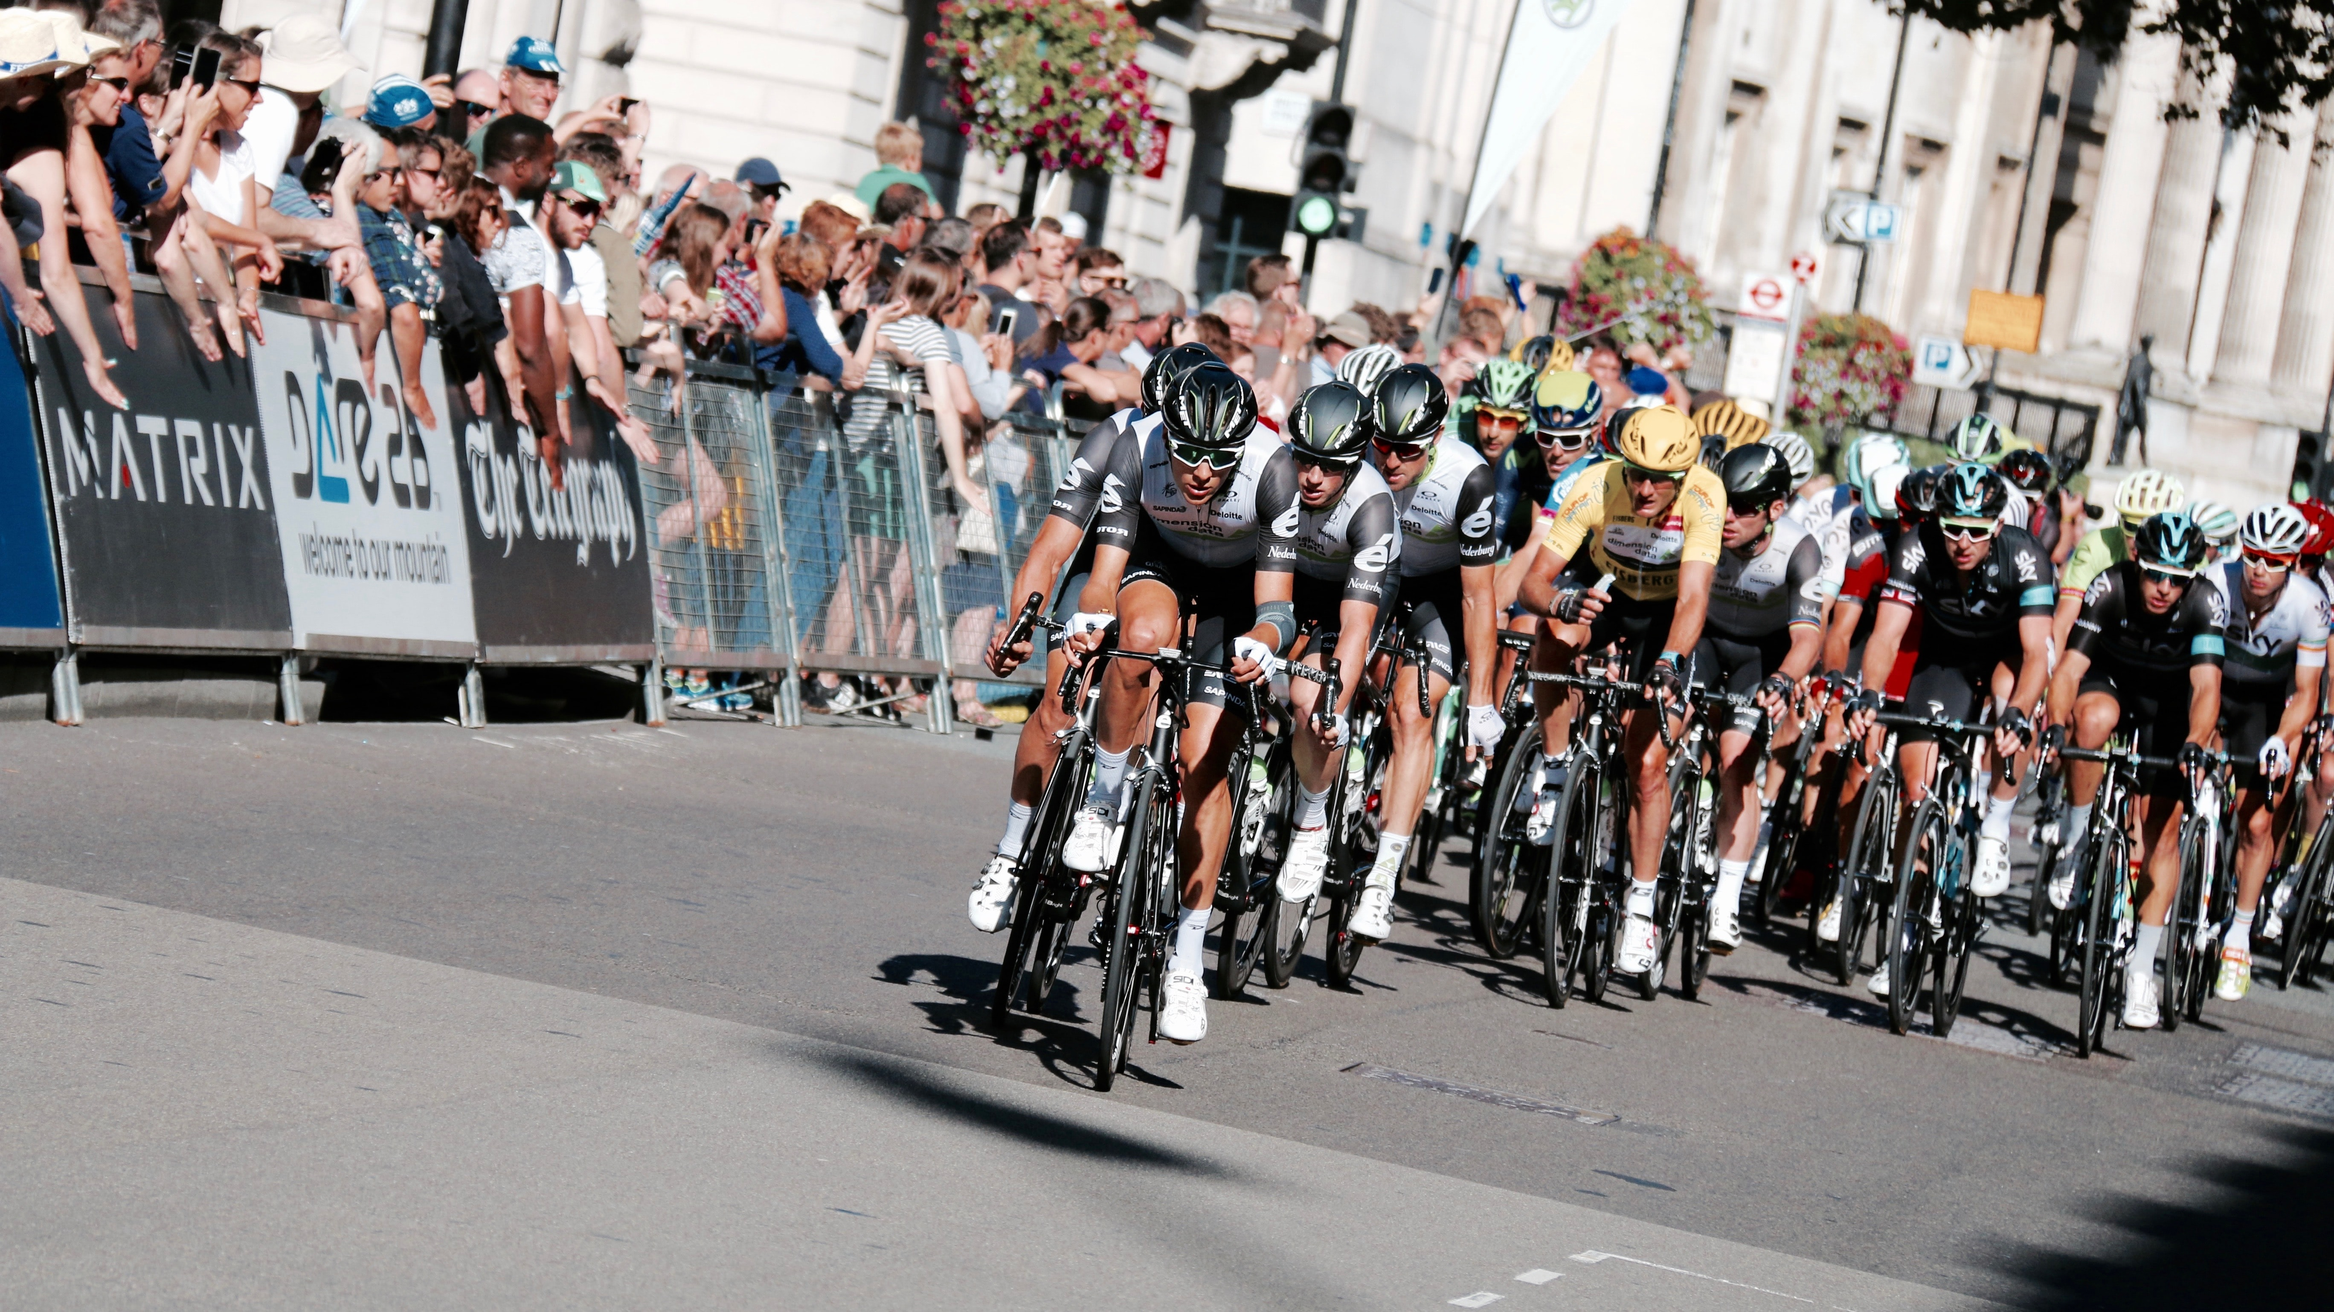

Business Analytics Proposal
Team 4 – MetricsNow Consulting

Slide 2

Agenda
Project Objective
Donor segmentation based on:
Prior vs. New participants
Team Divisions by Location
Connection to MS
Event registration/promotion
Recommendations
Conclusion

Slide 3
Project Objective
Problem
Our Objective
Strategy
Decline in fundraising revenue in Bike MS.over 2013-17
Using data visualisations to improve participant numbers and fundraising revenue in Bike MS by better understanding the donor segments.
Improving event organisation and event promotion by targeting specific donor segments.
Notes:
The substantial decline in fundraising revenue and participant numbers has been a major problem for Bike MS in recent years. So our consulting group’s primary objective is to use the data visualisations that we have developed to help Bike MS leverage the data from its charity cycling events to increase revenue and participant numbers. The way we will achieve this is to help the event organisers at Bike MS understand the donor segments so that they can enhance the way in which the events are organised and better promote them to potential participants.
For corporate organisations and nonprofit organisations alike, it is important to know where the most important source of revenue is coming from. Just as corporate organisations need to be aware of their customer segments, in Bike MS, this means that event organisers need to know who the biggest fundraisers are so that they can concentrate their efforts on tailoring the events to this particular segment, which will increase the likelihood that they will participate in future charity cycling events. For instance, if the majority of fundraisers are groups of friends, Bike MS can organise team competitions and promote it as an inclusive and social fundraising event to attract participants. This will ensure that the charity organisation does not risk losing its most important fundraisers to other charity events.
Our research has shown that out of the top 10 charity cycling events in the U.S., Bike MS is only 9th in terms of the funds raised, with a much greater proportion donated towards other causes, such as cancer and AIDS. Because of this, it is of the uttermost importance for Bike MS to keep its donor segments passionate about fundraising for the cause through better event organisation and promotional activities, which are key factors that the organisation can harness to differentiate itself from its competitors so that participants will be more inclined to participate in Bike MS’s charity events compared to other events. Targeting its donor segments through data-driven decisions is what will enable Bike MS to increase fundraising levels and the number of participants at cycling events.

Slide 4
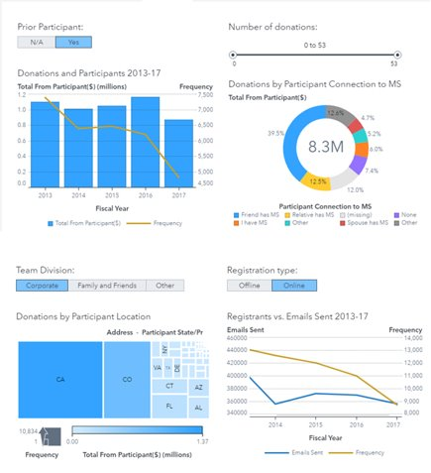

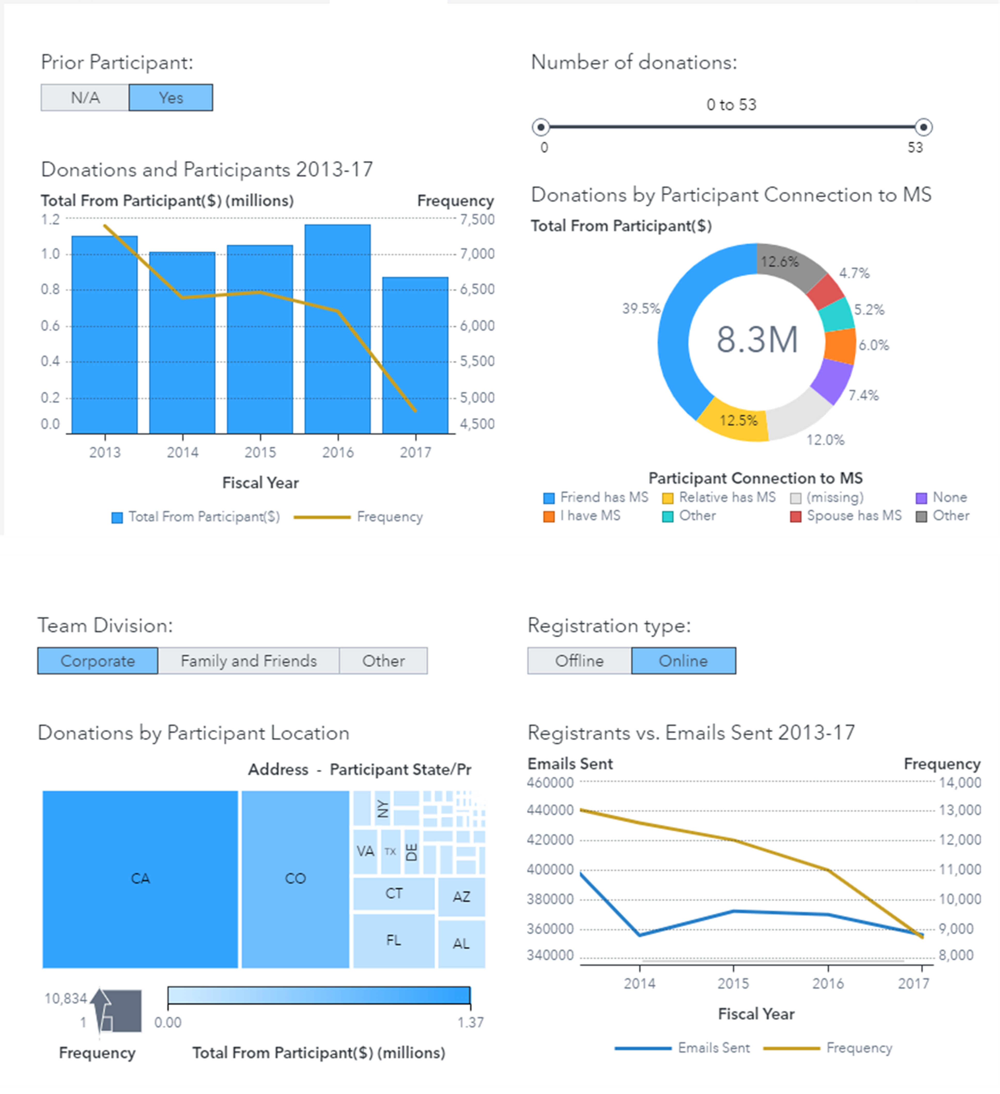
Dashboard

Slide 5
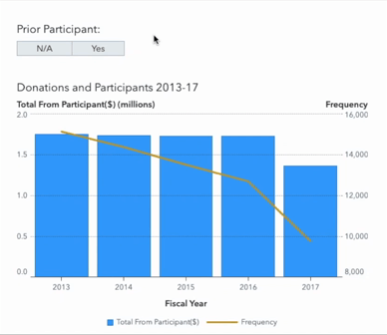
Prior Participants vs. New Participants
Chart Design
Dual axis bar line chart
Comparing donation amounts with participation numbers
Insights
The number of prior participants is slightly higher than those joining BikeMS events for the first time
Prior Participants donate more than non-prior participants
With the decrease in the number of participants, the fundraising also reduced.
Notes:
A dual-axis bar line chart can be used to better compare the donation amounts with participants numbers over the five years.
The number of returning participants is slightly higher than those who are participating in BikeMS’s events for the first time. From 2013 to 2017, the number of prior participants and non-prior participants decreased by 2575 and 2800 resepectively. With the decrease in the number of participants, the fundraising also reduced. Furthermore, prior participants donate more than non-prior participants. Therefore, donation amounts is related to participants numbers. Bike MS can find several ways to encourage participants to join the events again.

Slide 6
Prior Participants vs. New Participants
Assumptions
New participants may not be interested in BikeMS events
Prior participants are losing interest maybe due to poor event facilities
Notes:
There are two assumptions for this chart, new participants may not be interested in BikeMS events and prior participants are losing interest maybe due to poor event facilities

Slide 7


Recommendations
Provide a range of fitness level events
Create novelty and enjoyable events
Fitness test
Less rigorous events for new participants
A 20km ride
Challenge exercises for prior participants
a 100km ride or 170km ride.
Providing good quality and popular food
Providing comfortable accommodation to participants
Famous and beautiful venues
Notes:
To encourage more people to join BikeMS event and increase doanation amount, MetricsNow Consulting suggests that BikeMS host different levels of fitness events that accommodate various participants. To be specific, BikeMS can provide a fitness level test and give some suggestions to those who are not sure about their fitness levels. Choosing a suitable event can minimise the negative experience. New participants can select less rigorous events and some challenge exercises such as a 100km ride or 170km ride for those who have a high level of fitness
Furthermore, BikeMS can create novelty and enjoyable events by providing good quality food and comfortable accommodations to participants. Having some events at famous and beautiful venues can attract more people to join the events. In other words, those who have comfortable and enjoyable experience may have a higher chance to join events again, which may increase the number of participants and increase the amount of fundraising.

Slide 8
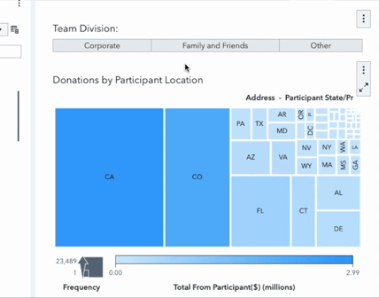
Team Divisions by Location
Chart Design
Efficient use of space
The sequential sizing order helps readers identify patterns and trends
Colour gradient shows which state/city accrued the most donations
Assumptions
Bike MS’s current promotional strategies include word-of-mouth, email, website and mobile application marketing.
The decline in fundraising revenue and participant numbers over the years suggest that Bike MS’s undifferentiated marketing is ineffective.

Slide 9
Team Divisions by Location
Insights
Majority of participants live in CA & CO
Highest corporate team participation:
CA – 45%
San Francisco
San Diego
CO – 25%
Denver

Slide 10


Recommendations for Corporates
Attracting corporate partnerships in targeted cities
Organize corporate challenges in targeted cities
Build a list of prospects within the targeted cities and prepare sponsorship proposals
Value propositions:
Increase brand awareness
Improve corporate governance
Market the event as an opportunity to expand your professional network and connect with likeminded people
Team building opportunity
Strategic ad placements at primary locations
Notes:
Attracting corporate partnership in targeted cities
- Gather a list of prospects in CA – San Francisco/San Diego & CO – Denver
- Prepare sponsorship proposal with value propositions – Increasing brand awareness, community presence, improve corporate governance, promote positive work culture
- Bike MS should pitch and highlight the benefits of partnership – enhancing the company's image, PR strategy, media awareness
Organise corporate challenges in targeted cities
- Market and promote the event as a networking event – a day for likeminded individuals to get together & share their common interests
- Able to meet new people & discover new business opportunities
- Strategic ad placement at locations where businessman/workers are more likely to see e.g. maximising subway advertising, coffee shops near corporate offices etc.

Slide 11
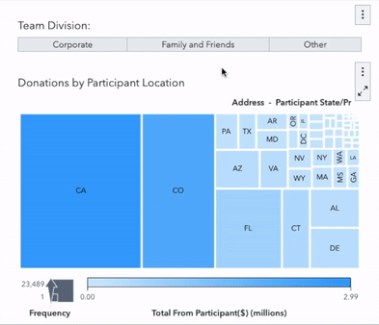
Team Divisions by Location
Insights
Majority of participants live in CA & CO
Highest Family and Friends participation:
CA – 33%
Los Angeles
Huntington Beach
CO – 22%
Centennial
Notes:
Location-based marketing refers to organisations targeting their consumers based on their physical location. By implementing targeted promotions, organisations can build a more refined business model that can capture the demands of specific customer segments (Marketing Evolution 2021).
On top of the cities targeted at corporates, family and friends also participate in BikeMS events too. From the team division tree map that 35% and 22% family and friends' participants live in the LA, Huntington Beach and Centennial areas.

Slide 12

Recommendations for Family and Friends
Location-based marketing
Promoting more family—friendly events
Segment market by the cities its participants live in, and total donations raised
Los Angeles (CA): raised $50,433
Huntington Beach (CA): raised $44,180.87
Centennial (CO): raised $158,003
Bike MS can focus on hosting their flagship events in these three cities.
Promoting the Bike MS event as a “fun family weekend activity” and not just an ordinary fundraising event.
Bike MS events for children like learning how to ride a bike and educational workshops.
Notes:
With 33% and 22% family and friend participants from California (CA) and Colorado (CO), LA, Huntington Beach and Centennial are the largest contributing cities to BikeMS events. From this, BikeMS can focus on hosting two flagship events in these these. They can then utilise their existing methods like email marketing to promote these events. This way, BikeMS not lose money and resources on locations with fewer participants and fundraising revenue.
MetricsNow Consulting recommends BikeMS to host and promote more family-friendly events.

Slide 13
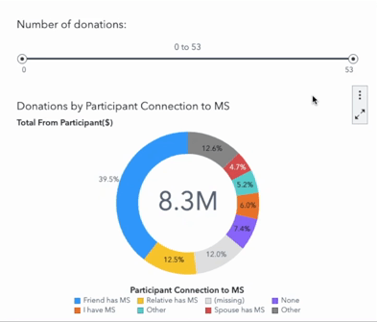
Connection to MS
Chart Design
Simple and easy to understand
Pie chart is practical for comparing similar categories
Assumptions
Missing values = no connection to MS
A participant's connection to MS can influence their own donation levels/amounts, but not their supporters' donations
Notes:
Our consulting group has designed a pie chart to compare the proportions of participants with a connection to MS. It is simple and easy to understand, so that insights can be grasped instantly. As most of the categories are similar e.g. relative has MS and parent has MS, a pie chart is more suitable than a treemap so that only the greatest proportions are shown. We have assumed that the missing data points are participants with no connection to MS to account for the total number of participants. Another assumption is that a participant’s connection to MS can affect how many times and how much they donate themselves, but has no impact on the donations of their supporters, hence we only analysed fundraising revenue from the participants themselves.

Slide 14
Connection to MS
Insights
Participants with a connection to MS are motivated more deeply by the cause
80% have friends or close family members with MS
92% of participants who donated 25 times or more have relatives with MS
BUT less than 20% of participants donate 3 times or more
Notes:
From a holistic view, the majority of participants have close family members or friends who are suffering from MS, which is likely what drives them to participate in these events. If we filter the number of donations, 92% of participants who donated 25 times or more have relatives with MS. It can be inferred that these participants really care about the cause, perhaps their relatives’ condition has had an immense impact on them so they want to help others suffering from the same disease. However, participants donating numerous times is rare, we can see that even for participants who have donated 3 times or more amounts to only $1.6 million, comprising less than 20% of the total donations of $8.3 million. Event organisers can use these findings to improve how they promote the events to participants motivated by a personal connection to the cause.

Slide 15
Recommendations
Promoting past event success
Success stories
Keeping participants informed about funds raised in previous years
Letting participants know they are making a difference
Telling success stories of how donations have improved the lives of individuals with MS
Ensures that they are committed to the cause and continue to help with fundraising
Notes:
For instance, the organisers can inform participants about the amount of funds raised over the previous years to let prior participants know about the impact that they are making, as well as encourage new participants to join the cause to further increase fundraising levels. They can also tell success stories about how the funds have been successfully used to improve the lives of individuals suffering from MS. Based on our research, this is a highly effective strategy to better promote the charity cycling events to participants who have a strong connection with the cause. If they know that they are making a difference, they will remain committed to the cause and continue to participate in future events, which will increase fundraising and participant numbers for Bike MS.

Slide 16
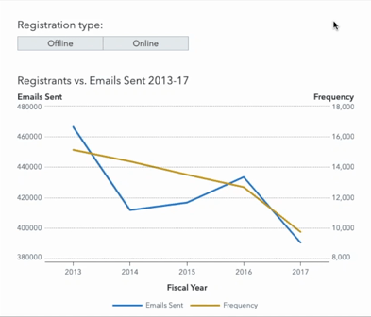
Event Registration/Promotion
Chart Design
Dual Axis Line Chart
Visualise trends over a time period for two different measures
Observe a correlation between the measures
Insights
Overall downward trend
Closest correlation seen with offline participants
Notes:
- dual axis line chart helps to better visualize change trends over time
- overall downward trend, and for online and offline registrant participation numbers
- close correlation observed with offline registrants

Slide 17
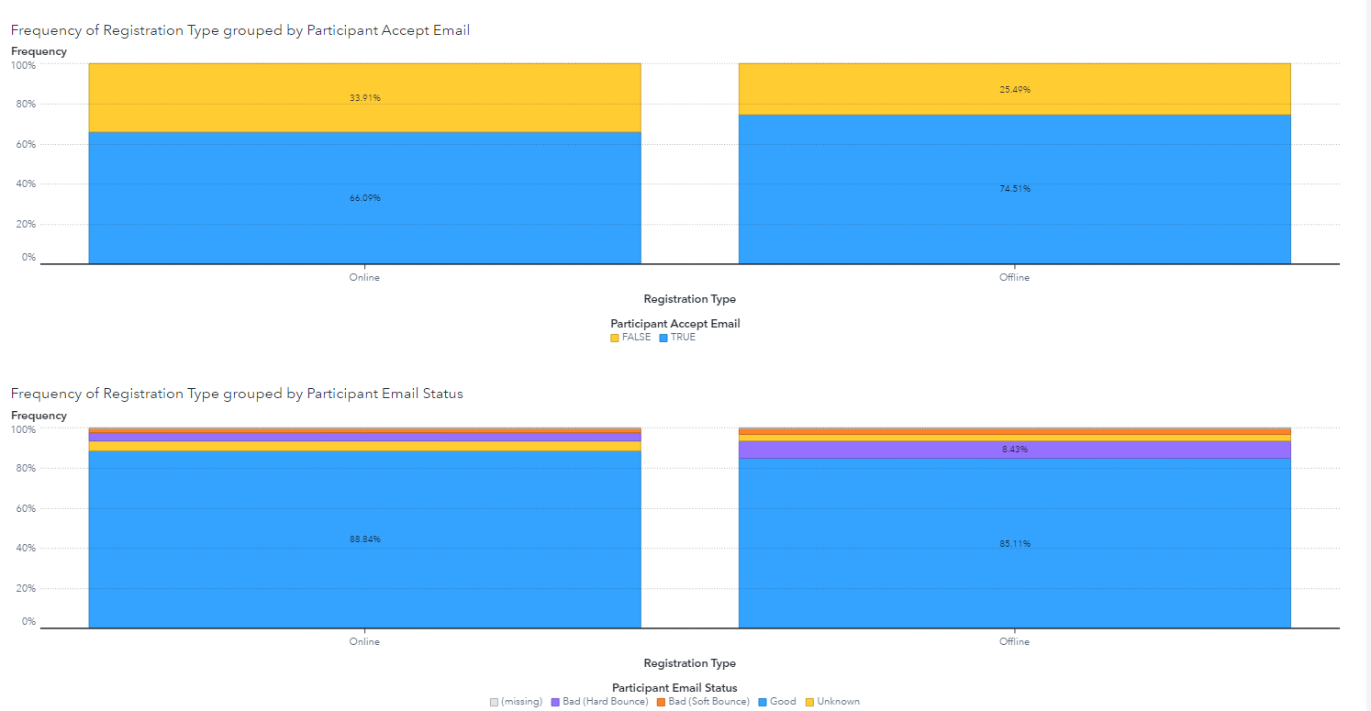
Event Registration/Promotion
Insights
Offline registrants more likely to read emails
However, emails more likely to bounce for offline registrants
Assumptions
Offline registrants are an older age demographic
Email bounces as result of invalid emails provided
Offline participant behaviour - more likely to attend events
Notes:
- Ironically offline registrants are more likely to read email
- Assumption participant behaviours – those who sign up in person are generally more interested in participating
- Views email for update on event, etc.
- Despite that, offline registrants emails more likely to bounce
- Assumption offline registrants are an older demographic that aren’t tech adept
- Result may be from invalid emails provided during registration process

Slide 18
Recommendations
Newsletters and SMS
Actively target registrants
Consistent emails across the fiscal year, not just heavy promotion near major event periods
SMS messages in the case of invalid email addresses
Market segmentation – inactive vs active registrants
Predictive Analytics – identify registrants who are likely to become inactive
Notes:
- newsletter subscriptions, statistics show 25% of recipients are likely to open marketing from non-profit orgs
- SMS updates
- actively target registrants based on inactive/active
- understand the donor segments
- utilize predictive analytics for customer retention

Slide 19

Conclusion
Targeting donor segments to improve event organisation/event promotion:
Prior participants
Corporate participants in specific locations
Participants with a connection to MS
Online registrants

Slide 20

Bibliography
Casais, B. & Santos, S. 2019, 'Corporate Propensity for Long-Term Donations to Non-Profit Organisations: An Exploratory Study in Portugal', Social Sciences, vol. 8, no. 1, accessed 8 April 2021, < https://search-proquest-com.wwwproxy1.library.unsw.edu.au/docview/2302647546?pq-origsite=primo>.
Chaffey, D. 2021, ‘How do you compare? 2021 average email open rates, clickthrough rates, and marketing statistics compilation’, SmartInsights, accessed 17 March, < https://www.smartinsights.com/email-marketing/email-communications-strategy/statistics-sources-for-email-marketing/>.
Funk, D & O’Brien, D 2011, ‘Examining Motivation for Charity Sport Event Participation: A Comparison of Recreation-Based and Charity-Based Motives’, Journal of Leisure Research, vol. 43, no. 4, accessed 28 March 2021,<https://www.tandfonline.com/doi/abs/10.1080/00222216.2011.11950247>.
Gran Fondo Guide, 2020, Top 10 U.S. Million Dollar Cycling Fundraising Events, accessed 28 March 2021, <https://granfondoguide.com/Contents/Index/5347/top-10-us-million-dollar-cycling-fundraising-events>.

Slide 21
Bibliography
Higgins, J & Hodgins, A 2008, ‘The Grape Escape–A FUNdraising Bike Tour for the Multiple Sclerosis Society’, Journal of Nonprofit & Public Sector Marketing, vol. 19, no. 2, accessed 27 March 2021, <https://www.tandfonline.com/doi/abs/10.1300/J054v19n02_03>.
Kim M 2021, Profile, Profile by Mungang Kim, Noun Project, accessed 22 March 2021, <https://thenounproject.com/mungang.kim/collection/profile/?i=2832950>.
Lake, H 2015, Movember uses location-based marketing to target potential participants, UK Fundraising, accessed 6 April 2021, <https://fundraising.co.uk/2015/11/24/movember-uses-location-based-marketing-to-target-potential-participants/>.
Marketing Evolution 2021, “What is Location-Based Marketing?”, viewed 10 April 2021,<https://www.marketingevolution.com/knowledge-center/topic/marketing-essentials/location-based-marketing#:~:text=Location%2Dbased%20marketing%20allows%20organizations,in%20their%20region%2C%20and%20more.>

Slide 22
Bibliography
MS Bike n.d, Corporate Teams, MS Bike, accessed 8 April 2021, < https://secure3.convio.net/mssoc/site/SPageServer/;jsessionid=00000000.app30115a?NONCE_TOKEN=5CA5EA334BAA694FF9E0DA5ACF1492C8&pagename=bike_nationalcompanyteam_NAT>
Snelgrove, R & Wood, L 2010, ‘Attracting and Leveraging Visitors at a Charity Cycling Event’, Journal of Sport and Tourism, vol. 15, no. 4, accessed 24 March 2021, <https://www.tandfonline.com/doi/full/10.1080/14775085.2010.533918>.
Taylor, R & Shanka, T 2008, ‘Cause for event: not-for-profit marketing through participant sports events’, Journal of Marketing Management, vol. 24, no. 9-10, accessed 25 March 2021, <https://www.tandfonline.com/doi/abs/10.1362/026725708X381984>.
Won, D, Park, M, Turner, B 2010, 'Motivations for participating in health-related charity sport events', Journal of Venue & Event Management, vol. 1, no.1, pp17-44, accessed 1 April 2021, < https://www.researchgate.net/publication/269996386_Motivations_for_participating_in_health_related_charity_sport_events>.

Slide 23
Bibliography
Wood, L, Snelgrove, R, Danylchuk, K 2010, ‘Segmenting Volunteer Fundraisers at a Charity Sport Event’, Journal of Nonprofit & Public Sector Marketing, vol. 22, no. 1, accessed 24 March 2021, <https://www.tandfonline.com/doi/full/10.1080/10495140903190408>.

Slide 24


Thank You
Team 4 - MetricsNow Consulting

